Slide 1
Self-Organizing Maps
Materi Corby Ziesman
Digabungkan dengan materi dari penulis2 lain

Slide 2
Overview
A Self-Organizing Map (SOM) is a way to represent higher dimensional data in an usually 2-D or 3-D manner, such that similar data is grouped together.
It runs unsupervised and performs the grouping on its own.
Once the SOM converges, it can only classify new data. It is unlike traditional neural nets which are continuously learning and adapting.
SOMs run in two phases:
Training phase: map is built, network organizes using a competitive process, it is trained using large numbers of inputs (or the same input vectors can be administered multiple times).
Mapping phase: new vectors are quickly given a location on the converged map, easily classifying or categorizing the new data.

Slide 3
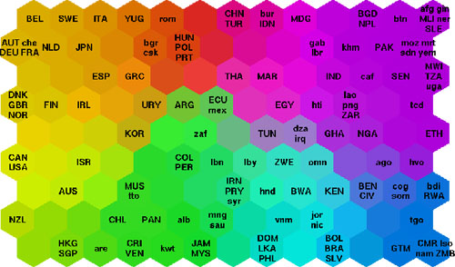
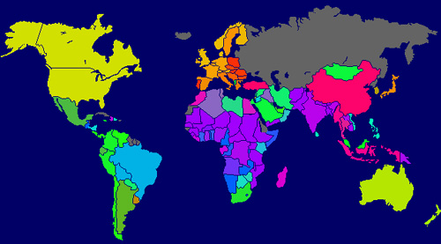
Uses
→
Example: Data sets for poverty levels in different countries.
Data sets have many different statistics for each country.
SOM does not show poverty levels, rather it shows how similar the poverty sets for different countries are to each other. (Similar color = similar data sets).

Slide 4
Forming the Map

Slide 5
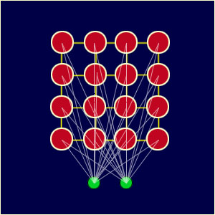
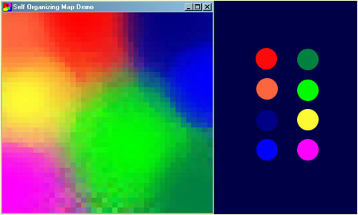
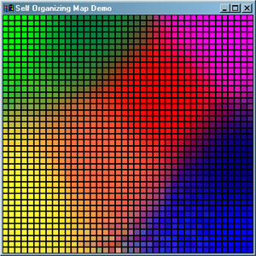
SOM Structure
Every node is connected to the input the same way, and no nodes are connected to each other.
In a SOM that judges RGB color values and tries to group similar colors together, each square “pixel” in the display is a node in the SOM.
Notice in the converged SOM above that dark blue is near light blue and dark green is near light green.

Slide 6
The Basic Process
Initialize each node’s weights.
Choose a random vector from training data and present it to the SOM.
Every node is examined to find the Best Matching Unit (BMU).
The radius of the neighborhood around the BMU is calculated. The size of the neighborhood decreases with each iteration.
Each node in the BMU’s neighborhood has its weights adjusted to become more like the BMU. Nodes closest to the BMU are altered more than the nodes furthest away in the neighborhood.
Repeat from step 2 for enough iterations for convergence.

Slide 7
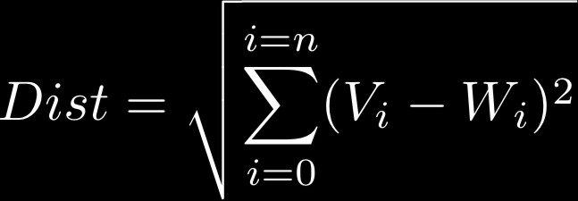
Calculating the Best Matching Unit
Calculating the BMU is done according to the Euclidean distance among the node’s weights (W₁, W₂, … , W_{n}) and the input vector’s values (V₁, V₂, … , V_{n}).
This gives a good measurement of how similar the two sets of data are to each other.

Slide 8


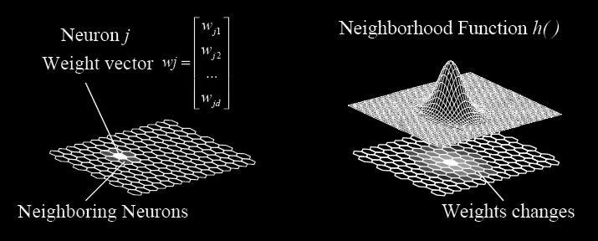
Determining the BMU Neighborhood
Size of the neighborhood: We use an exponential decay function that shrinks on each iteration until eventually the neighborhood is just the BMU itself.
Effect of location within the neighborhood: The neighborhood is defined by a gaussian curve so that nodes that are closer are influenced more than farther nodes.

Slide 9

Modifying Nodes’ Weights
The new weight for a node is the old weight, plus a fraction (L) of the difference between the old weight and the input vector… adjusted (theta) based on distance from the BMU.
The learning rate, L, is also an exponential decay function.
This ensures that the SOM will converge.
The lambda represents a time constant, and t is the time step

Slide 10
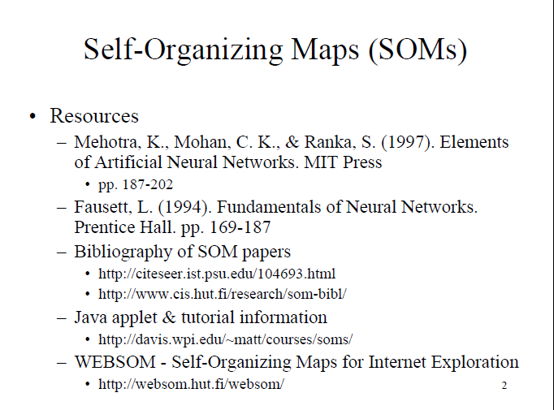

Slide 11
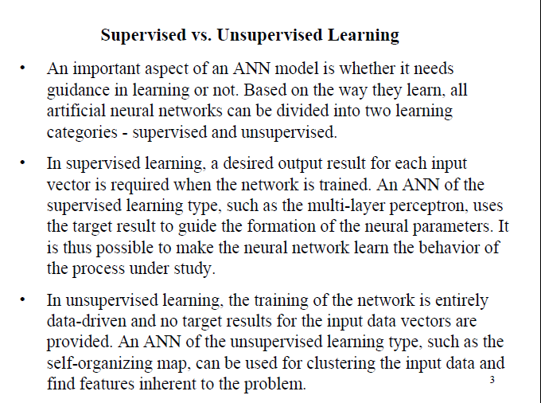

Slide 12
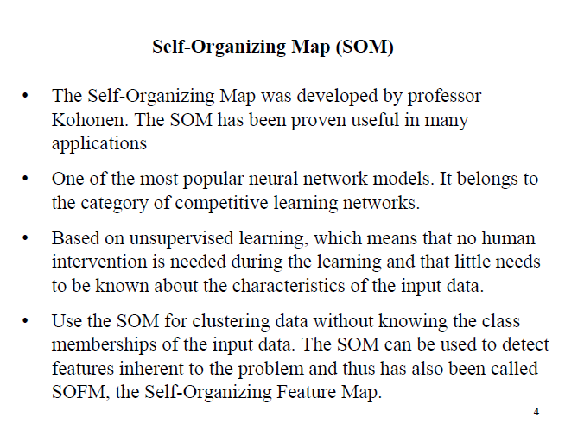

Slide 13
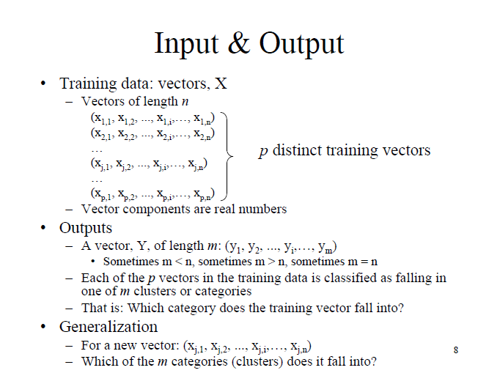

Slide 14
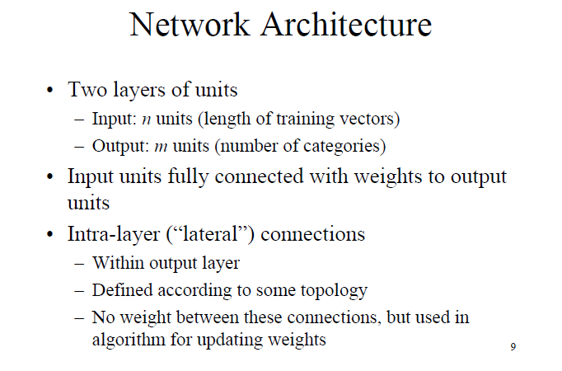

Slide 15
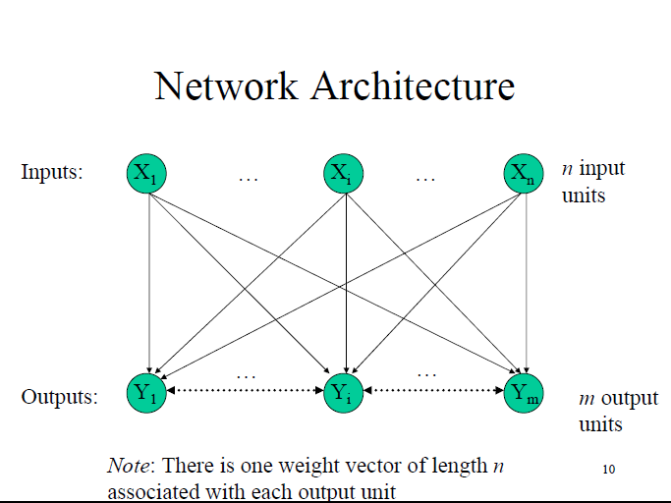

Slide 16
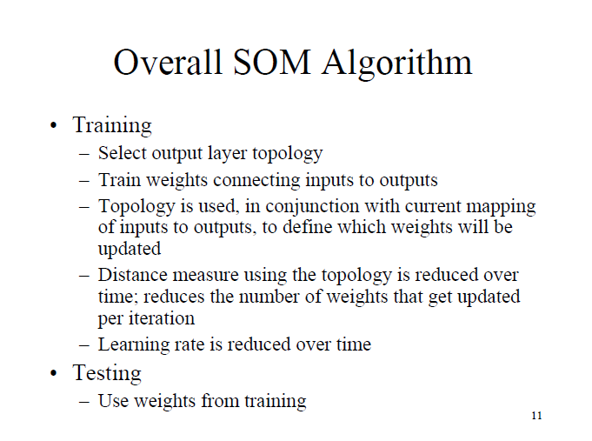

Slide 17
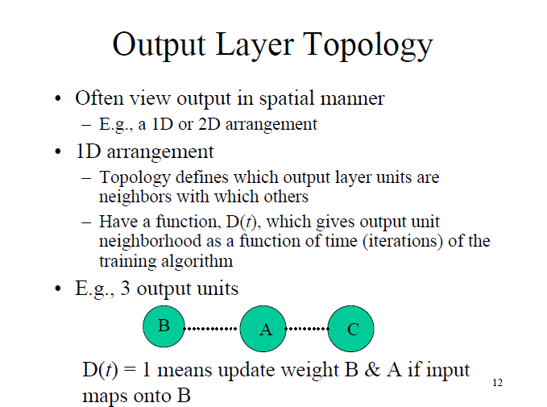

Slide 18
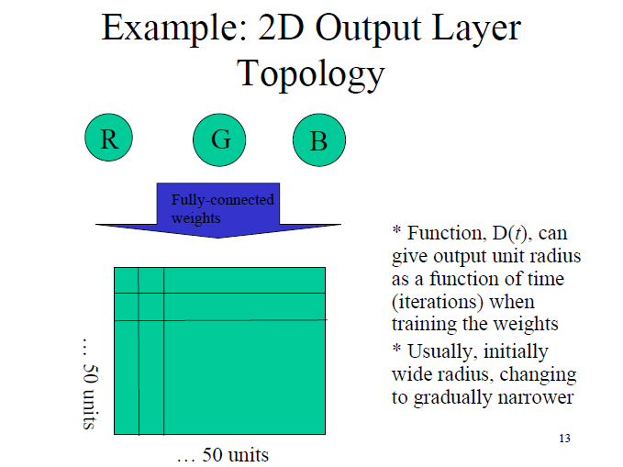

Slide 19
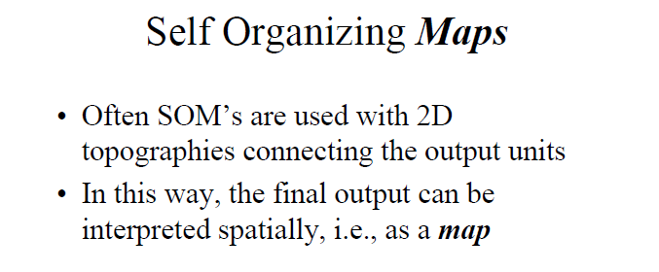

Slide 20
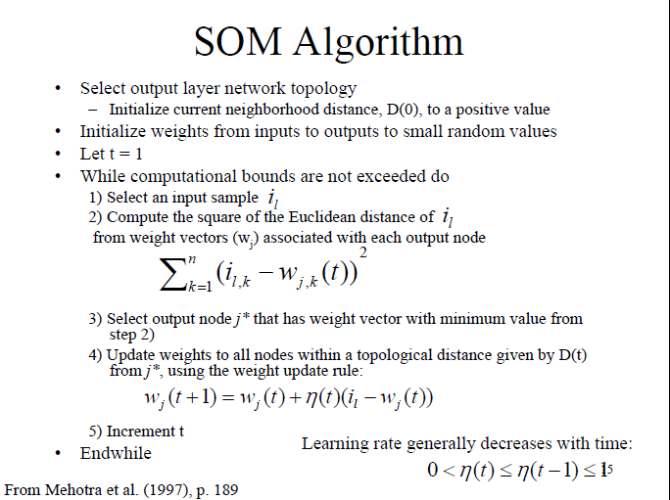

Slide 21
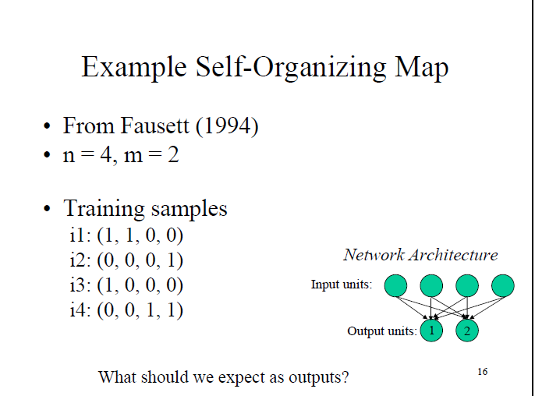

Slide 22
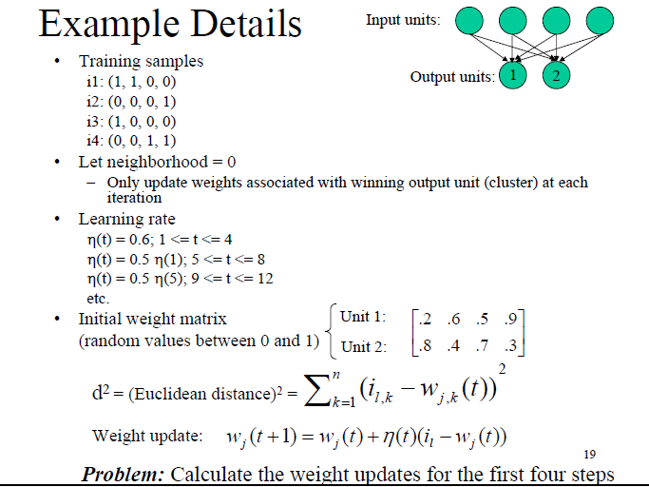

Slide 23
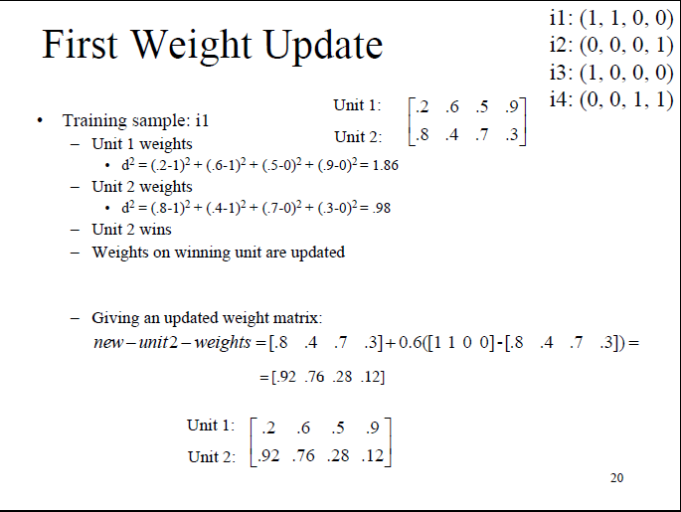

Slide 24
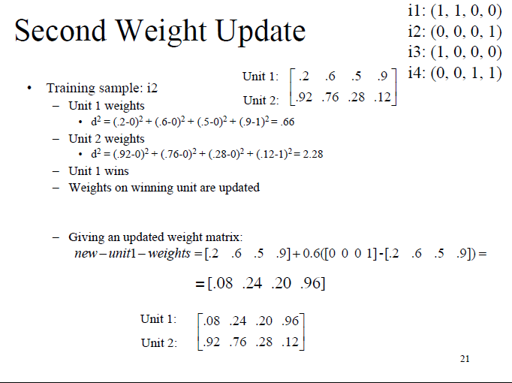

Slide 25
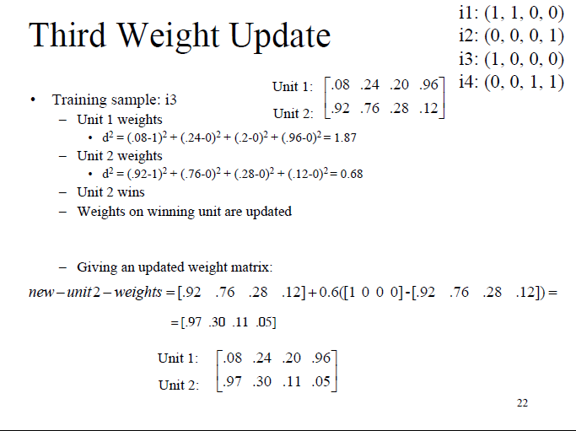

Slide 26
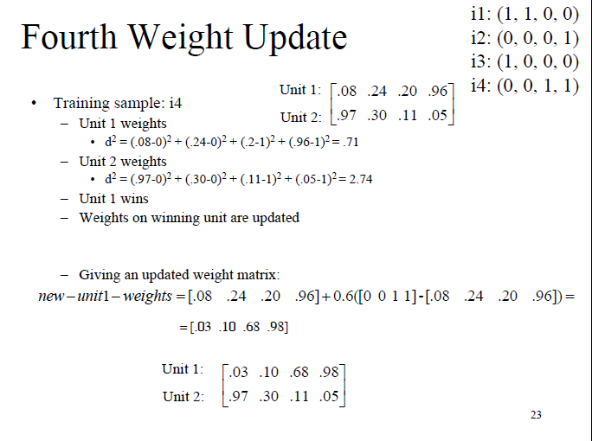

Slide 27
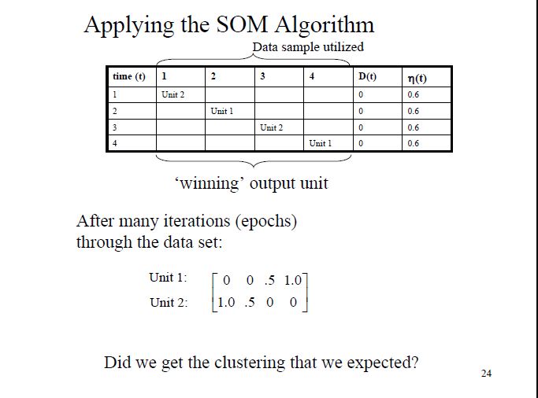

Slide 28
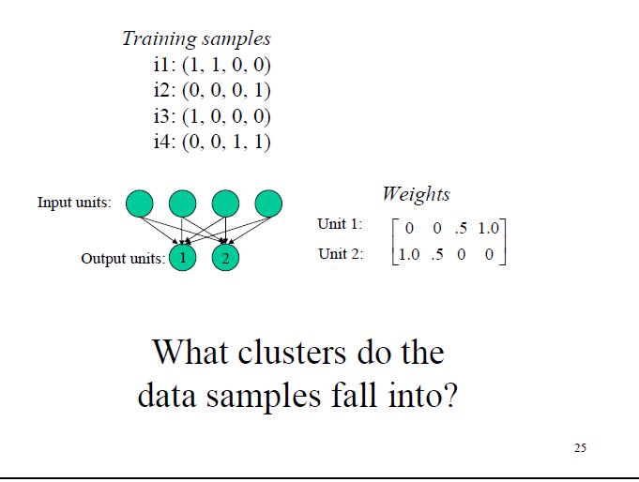

Slide 29
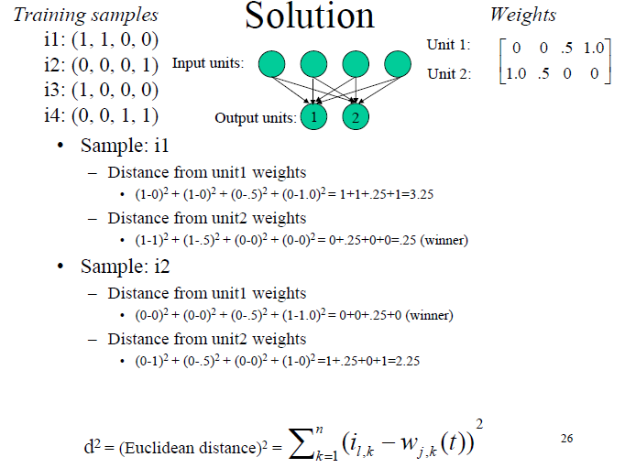

Slide 30
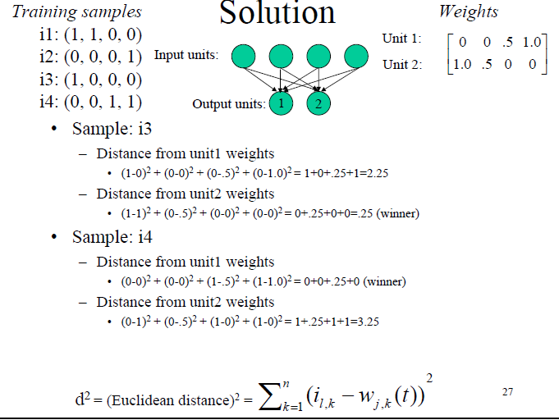

Slide 31
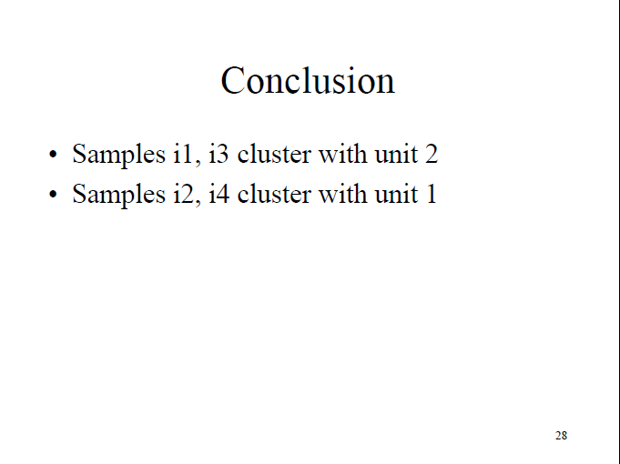

Slide 32
See It in Action

Slide 33
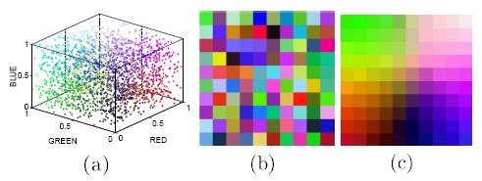
Example 1
2-D square grid of nodes.
Inputs are colors.
SOM converges so that similar colors are grouped together.
Program with source code and pre-compiled Win32 binary: http://www.ai-junkie.com/files/SOMDemo.zip or mirror.
Input space
Initial weights
Final weights

Slide 34
References
Wireless Localization Using Self-Organizing Maps by Gianni Giorgetti, Sandeep K. S. Gupta, and Gianfranco Manes. IPSN ’07.
Wikipedia: “Self organizing map”. http://en.wikipedia.org/wiki/Self-organizing_map. (Retrieved March 21, 2007).
AI-Junkie: “SOM tutorial”. http://www.ai-junkie.com/ann/som/som1.html. (Retrieved March 20, 2007).

Slide 35
Evaluating cluster quality
Use known classes (pairwise F-measure, best class F-measure)
Clusters can be evaluated with “internal” as well as “external” measures
Internal measures are related to the inter/intra cluster distance
External measures are related to how representative are the current clusters to “true” classes

Slide 36
Inter/Intra Cluster Distances
Intra-cluster distance
(Sum/Min/Max/Avg) the (absolute/squared) distance between
All pairs of points in the cluster OR
Between the centroid and all points in the cluster OR
Between the “medoid” and all points in the cluster
Inter-cluster distance
Sum the (squared) distance between all pairs of clusters
Where distance between two clusters is defined as:
distance between their centroids/medoids
(Spherical clusters)
Distance between the closest pair of points belonging to the clusters
(Chain shaped clusters)

Slide 37
Davies-Bouldin index
A function of the ratio of the sum of within-cluster (i.e. intra-cluster) scatter to between cluster (i.e. inter-cluster) separation
Let C={C₁,….., C_{k}} be a clustering of a set of N objects:
with and
where C_{i} is the i^{th} cluster and c_{i} is the centroid for cluster i

Slide 38

Davies-Bouldin index example
For eg: for the clusters shown
Compute
var(C₁)=0, var(C₂)=4.5, var(C₃)=2.33
Centroid is simply the mean here, so c₁=3, c₂=8.5, c₃=18.33
So, R₁₂=1, R₁₃=0.152, R₂₃=0.797
Now, compute
R₁=1 (max of R₁₂ and R₁₃); R₂=1 (max of R₂₁ and R₂₃); R₃=0.797 (max of R₃₁ and R₃₂)
Finally, compute
DB=0.932

Slide 39

Davies-Bouldin index example (ctd)
For eg: for the clusters shown
Compute
Only 2 clusters here
var(C₁)=12.33 while var(C₂)=2.33; c₁=6.67 while c₂=18.33
R₁₂=1.26
Now compute
Since we have only 2 clusters here, R₁=R₁₂=1.26; R₂=R₂₁=1.26
Finally, compute
DB=1.26

Slide 40
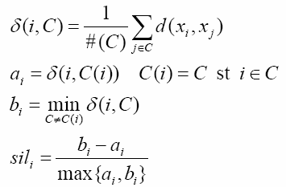

Other criteria
Dunn method
δ(X_{i}, X_{j}): intercluster distance between clusters X_{i} and X_{j} Δ(X_{k}): intracluster distance of cluster X_{k}
Silhouette method
Identifying outliers
C-index
Compare sum of distances S over all pairs from the same cluster against the same # of smallest and largest pairs.
Notes:
C-index S is the sum of distances over all pairs of patterns from the same cluster. Let l be the number of those pairs. Then S_{min} is the sum of the l smallest distances if all pairs of patterns are considered (i.e. if the patterns can belong to different clusters). Similarly S_{max} is the sum of the l largest distance out of all pairs. Hence a small value of C indicates a good clustering.

